Slide 1



Cable flexing, polymer deformation, and fatigue
2026 Mathematical Problem in Industry (MPI) Workshop
W.L. Gore Associates, Inc.
June 18, 2026
Linda J. Cummings, Abhijnan Dikshit‬, Tomás Gillanders, Cecilia Mondaini,
Terhi Nurminen, Pejman Sanaei, Burt Tilley​

Slide 2

Application & motivation

Slide 3
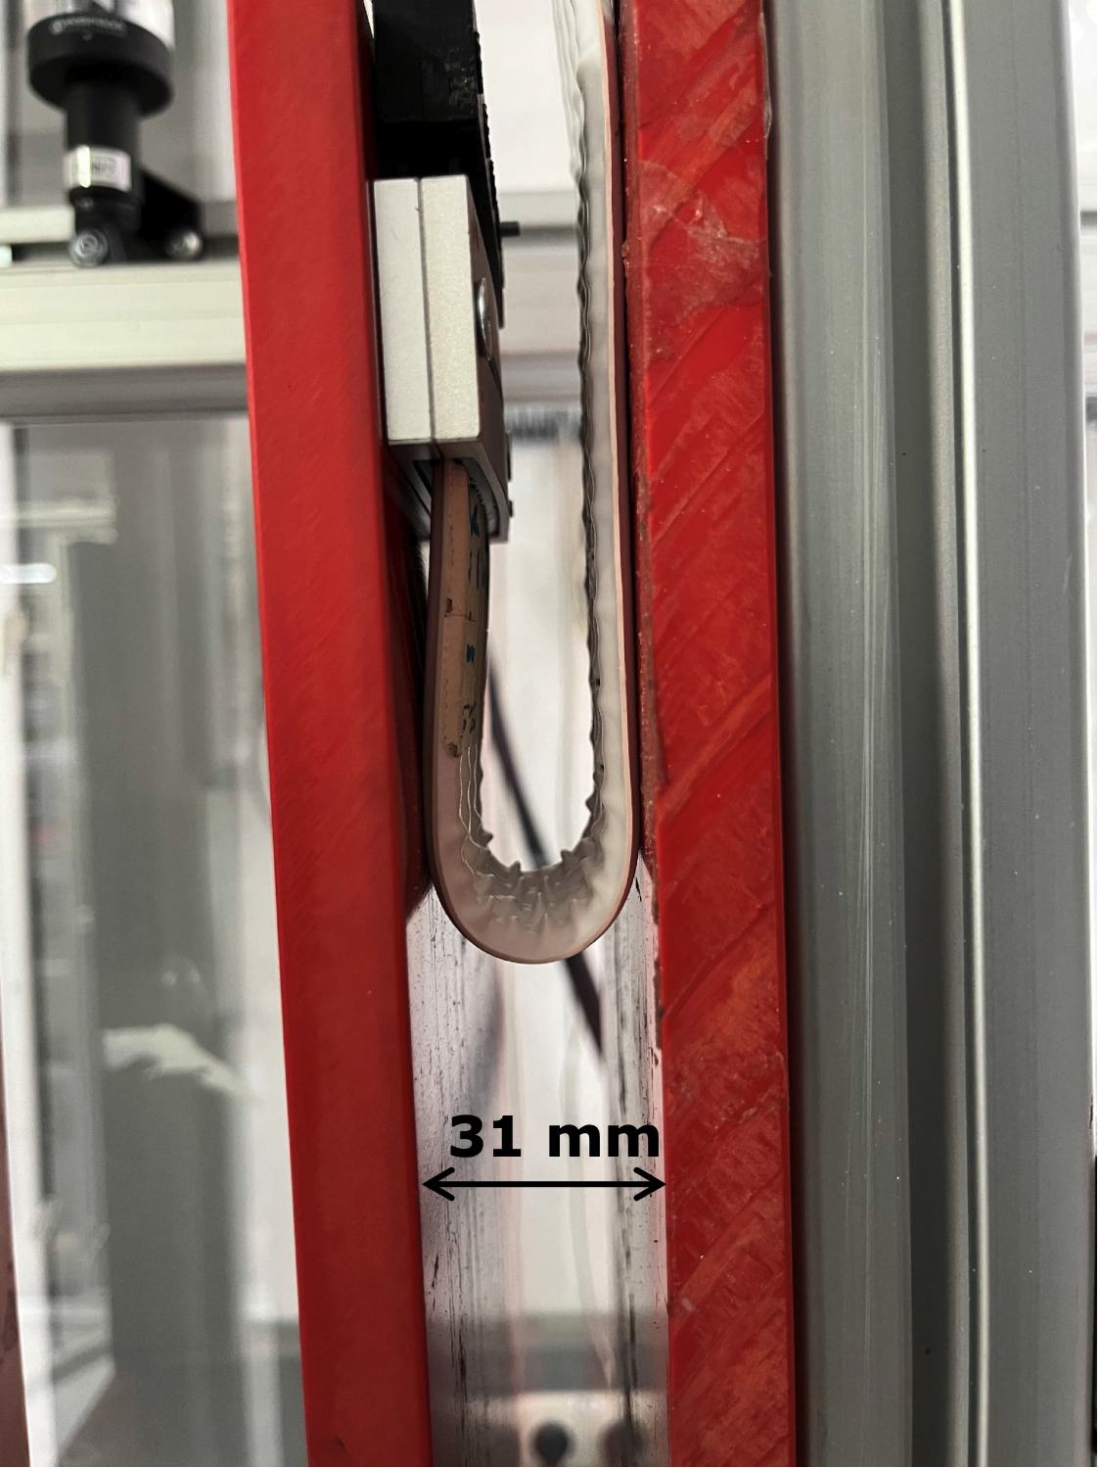
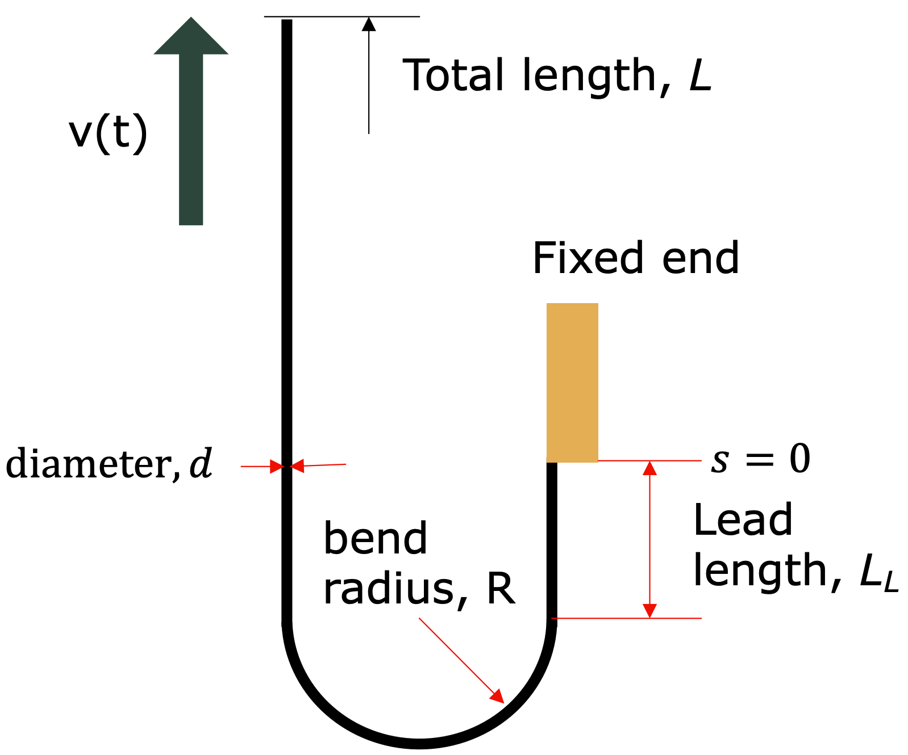
Experimental setup

Slide 4
Objectives identified by Gore
What is the stress, strain, and strain rate inside the cable at different cycling velocities and geometries?
How does the polymeric mechanical model change the stress, strain, and strain rate?
Polymer materials properties can be highly resolved by torsional shear testing. Can the stress, strain and strain rates of the cycled cable be transformed into torsional shear test inputs?
How will the cycle time/velocity change the performance over time?

Slide 5
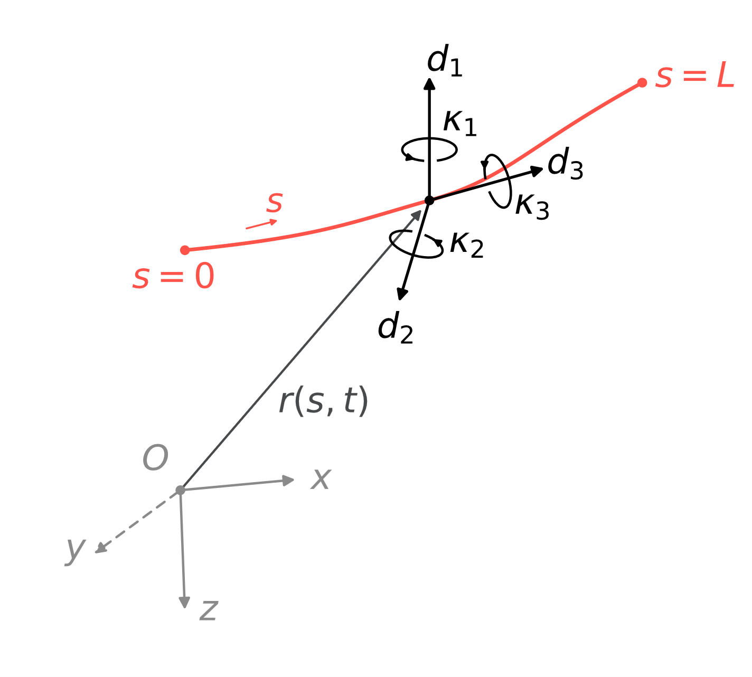
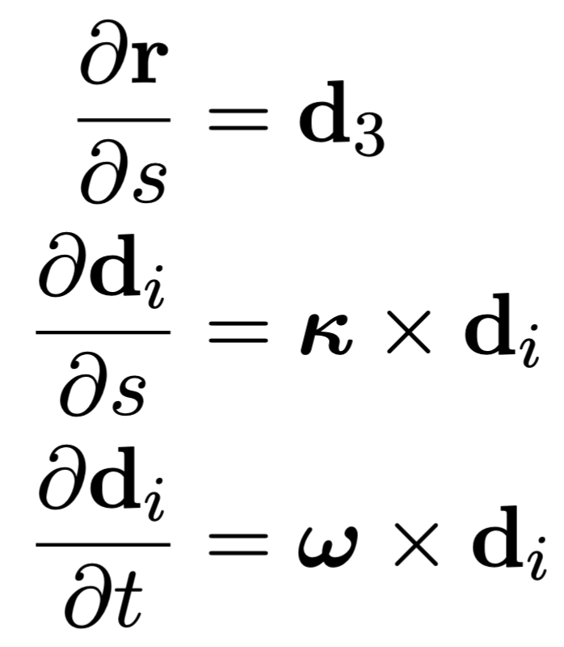
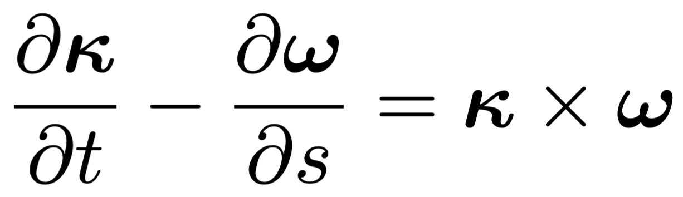
Geometry of space curves
Kinematic equations
Compatibility condition
Goriely, A. and Tabor, M., 1997. Nonlinear dynamics of filaments I. Dynamical instabilities. Physica D: Nonlinear Phenomena

Slide 6
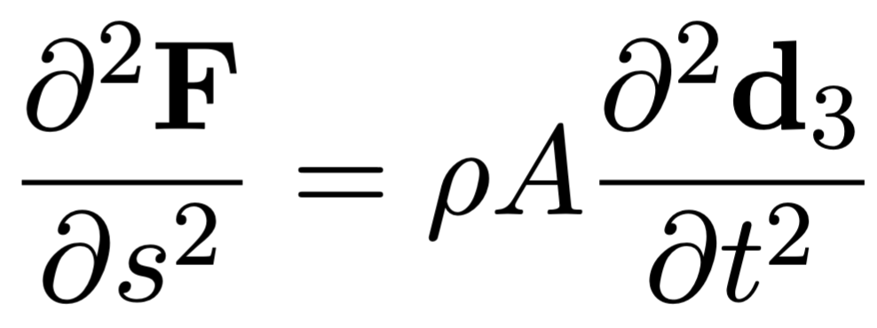
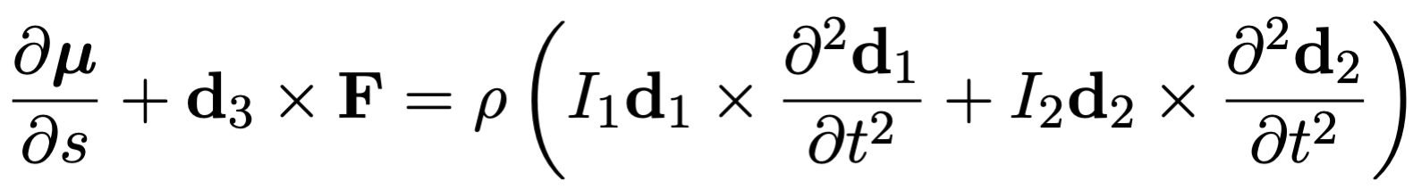
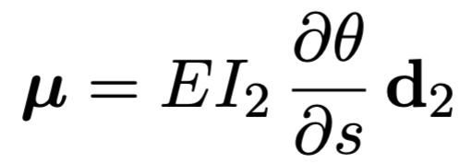
Mechanics of cables
Force balance
Momentum balance
Elastic constitutive law

Slide 7
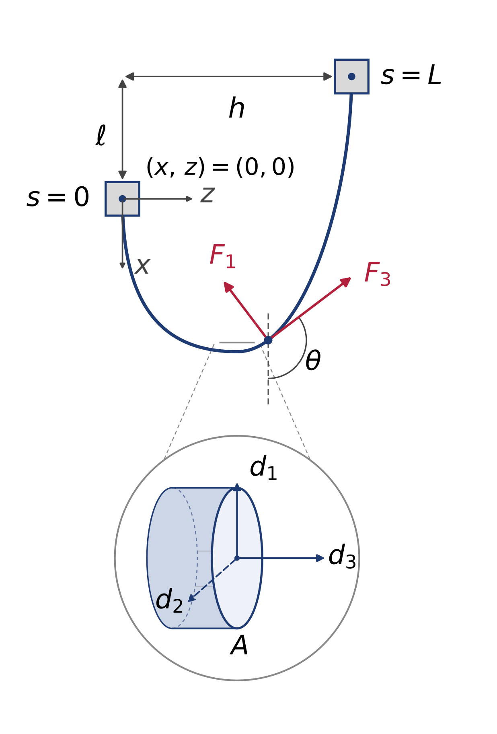
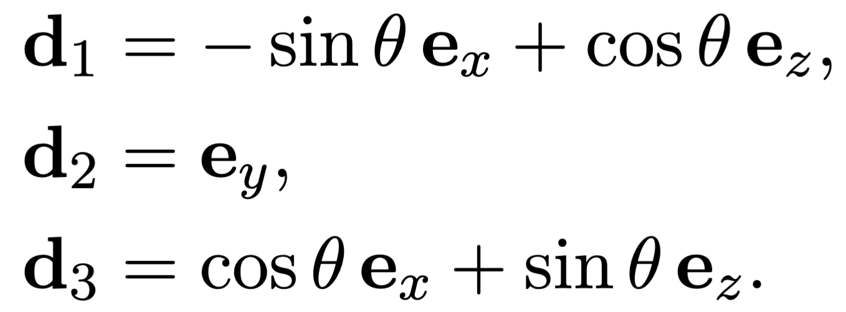
The planar problem

Slide 8
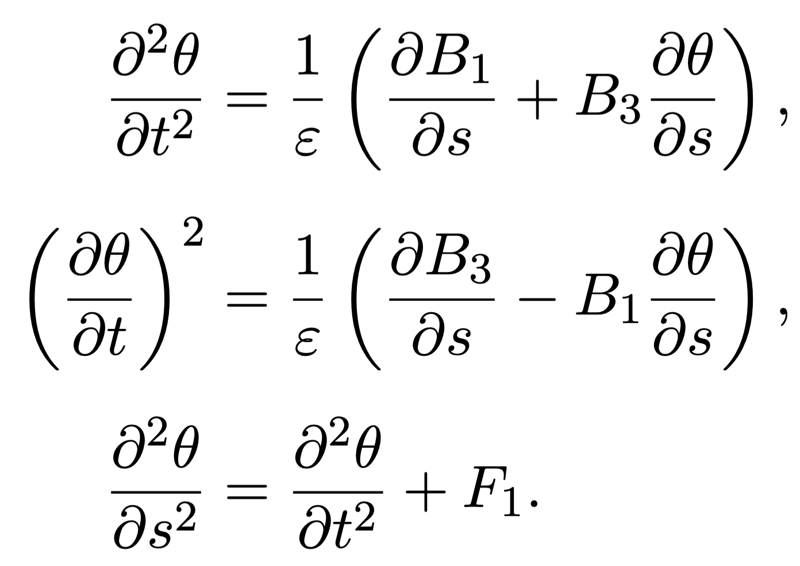
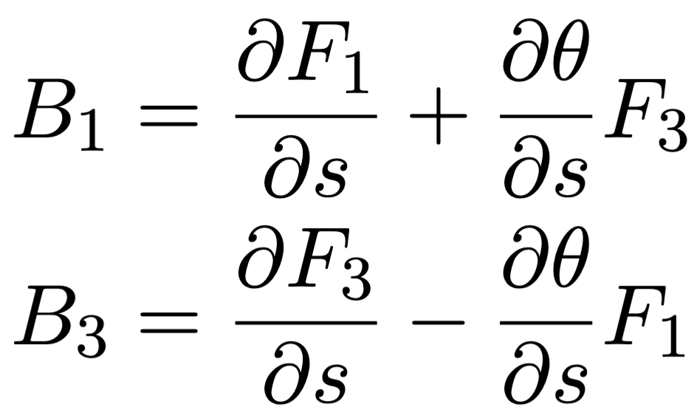
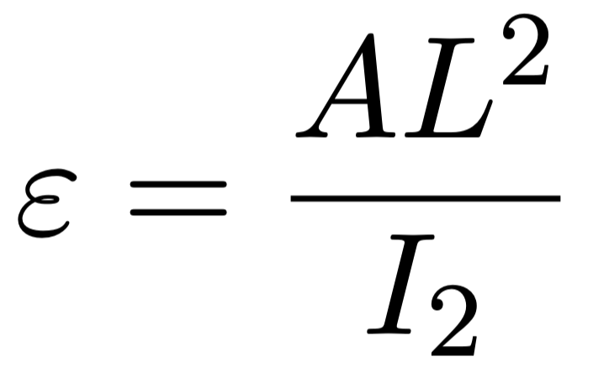
Dynamic sheet equations
Balance laws become

Slide 9
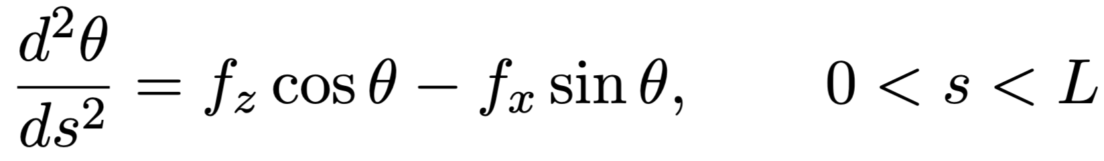
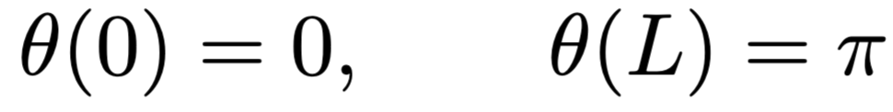
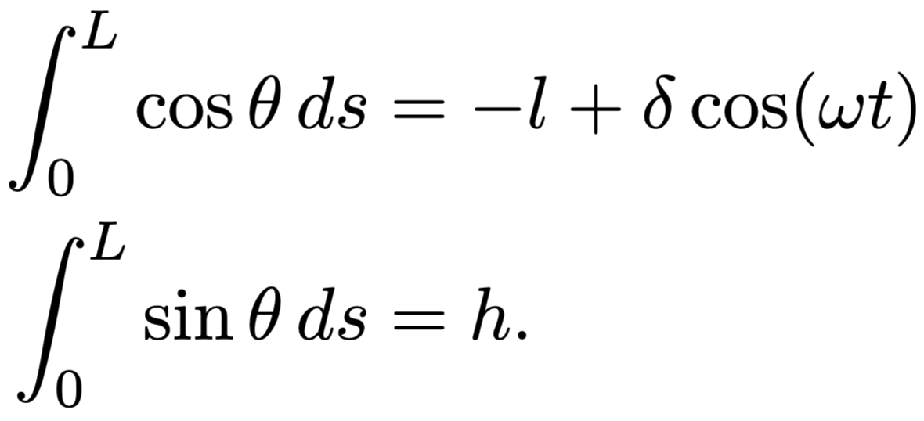
Free static sheet
Clamped-clamped boundary conditions
Time dependent end separation integral constraints​

Slide 10
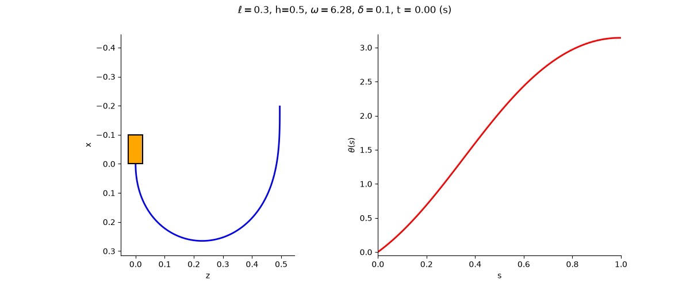
Solutions of free sheet

Slide 11
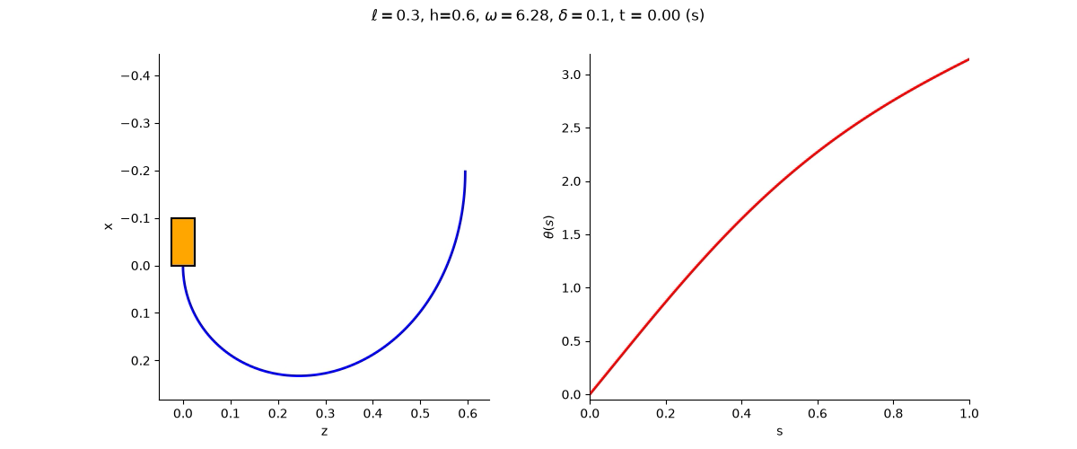
Solutions of free sheet

Slide 12
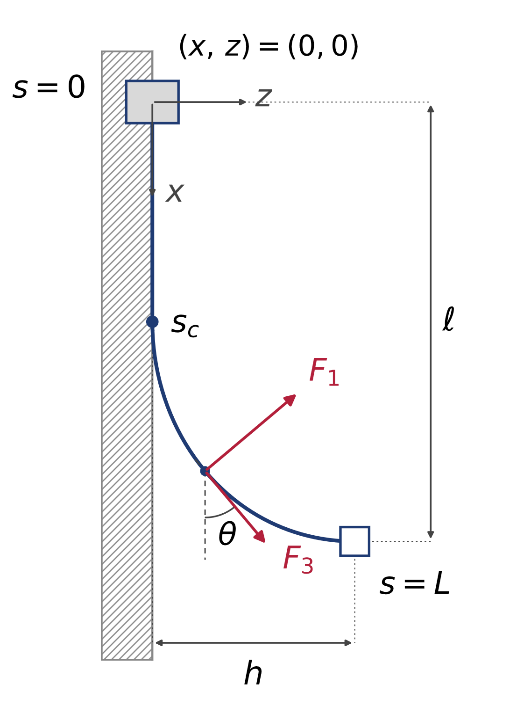
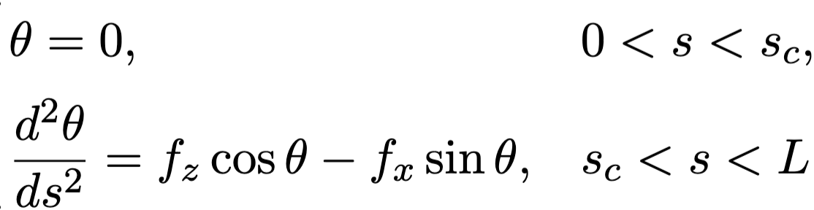
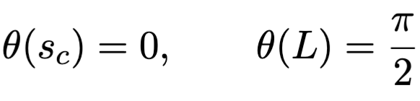
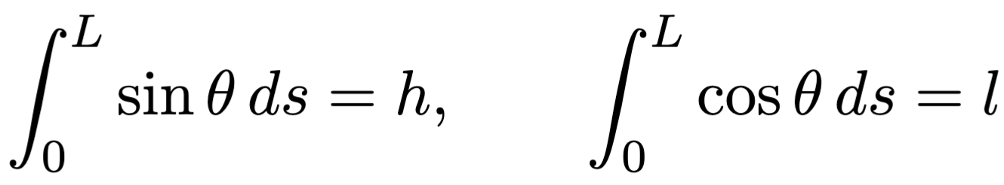
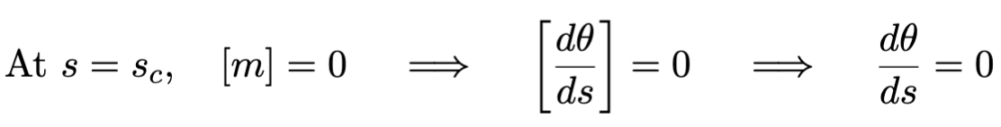
Static contact problem
Clamped boundary conditions
Geometric integral constraints​

Slide 13
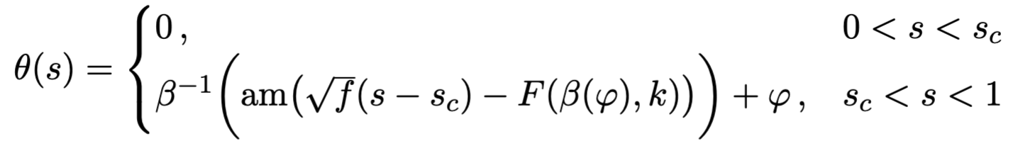
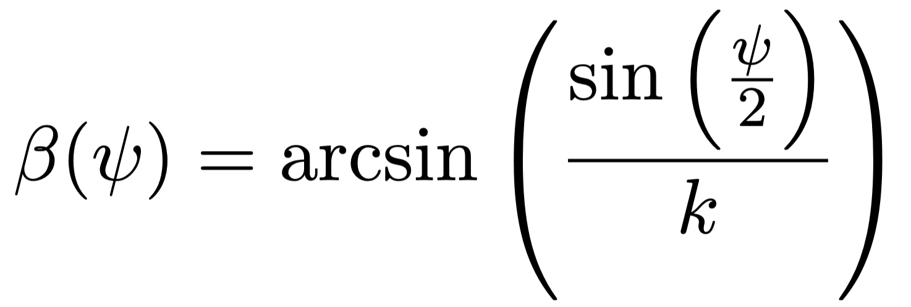
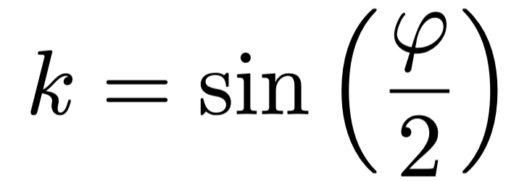
Contact problem continued

Slide 14
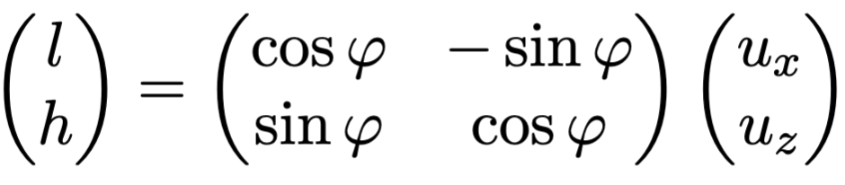
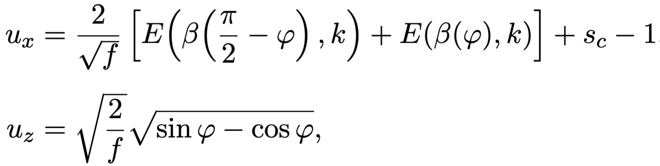
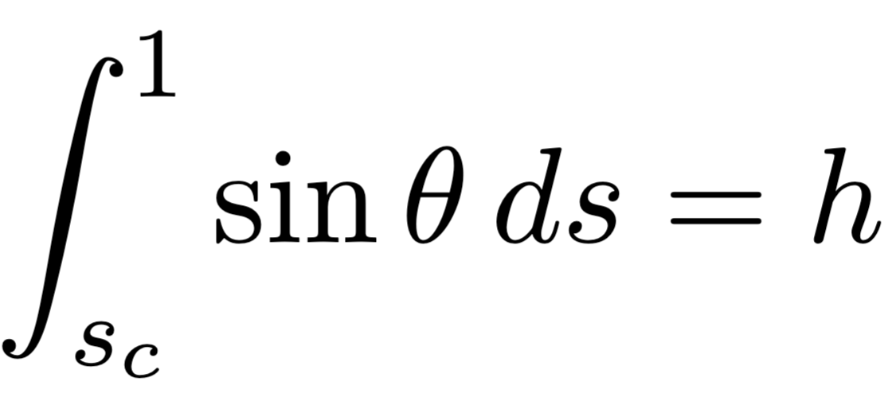
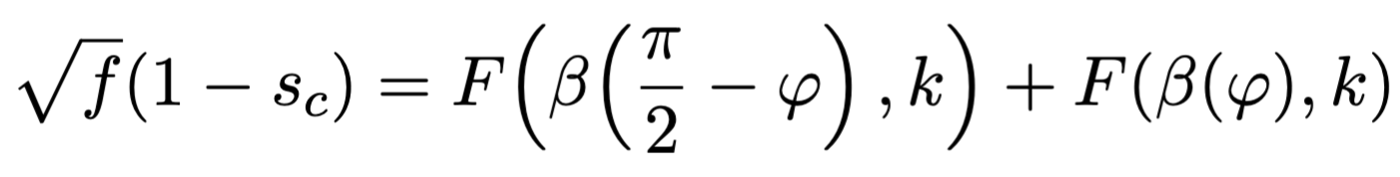
Contact problem continued

Slide 15
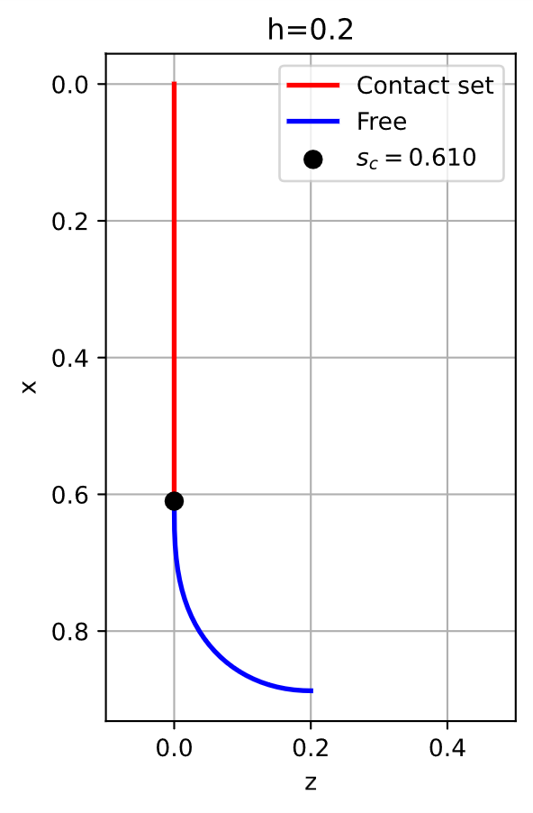
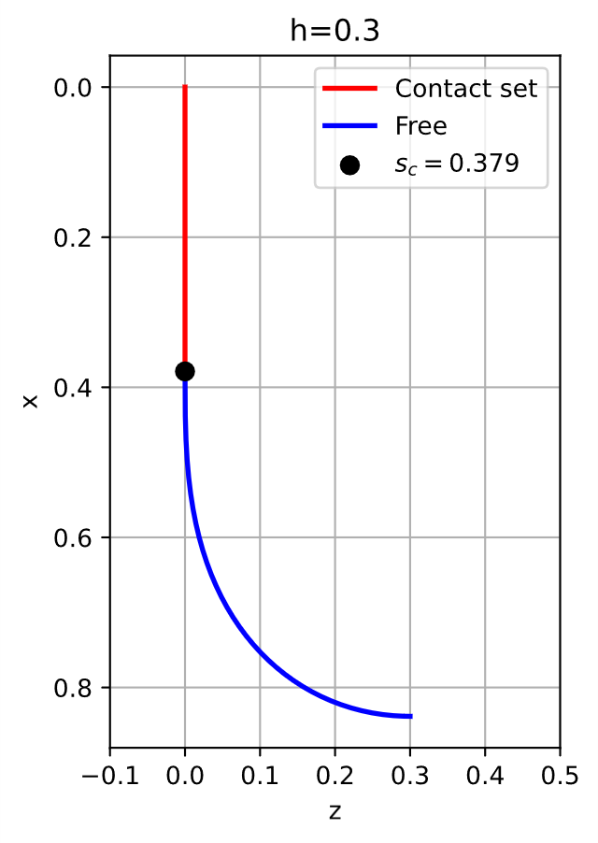
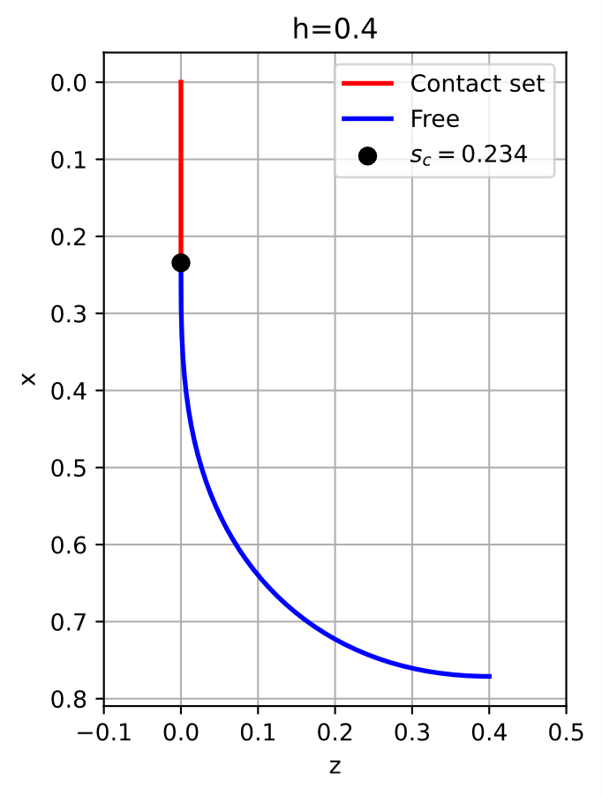
Contact problem solutions

Slide 16
Dynamic sheet equations
Balance laws become

Slide 17
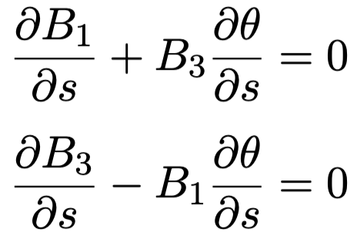
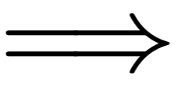

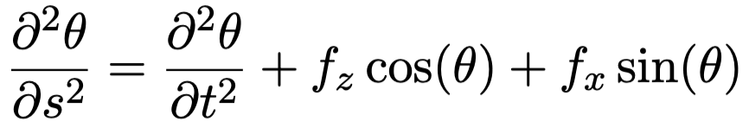

Dynamic equations: Asymptotic approach
Taking the $ε→0$ asymptotic limit, the problem to leading order in $ε$ becomes:
Sine-Gordon equation

Slide 18
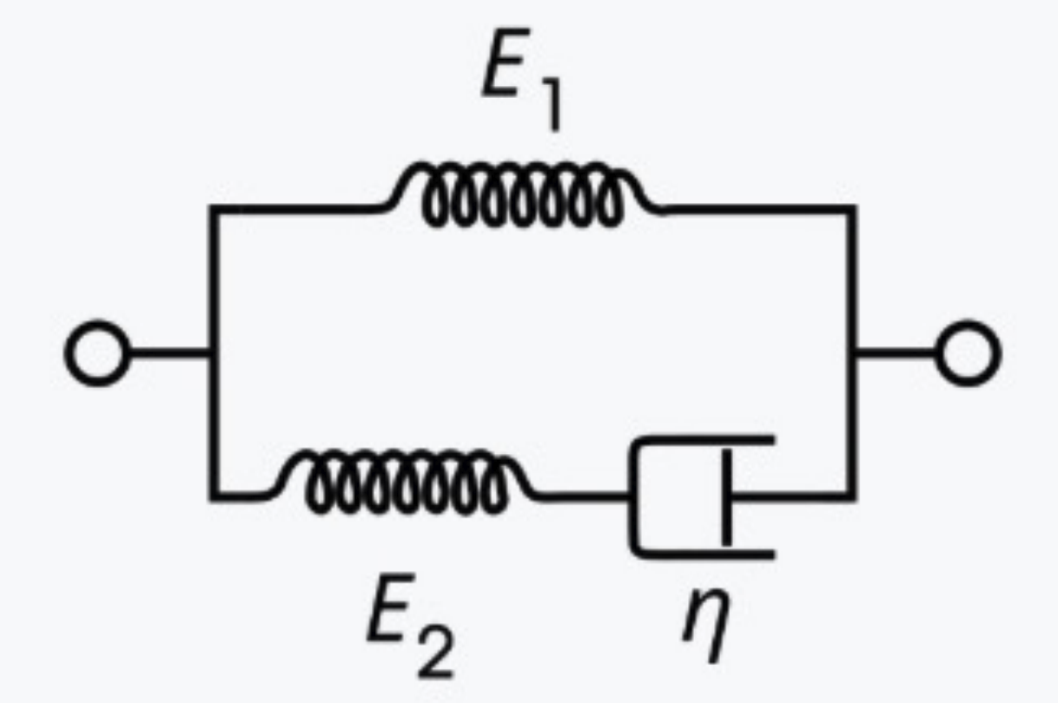
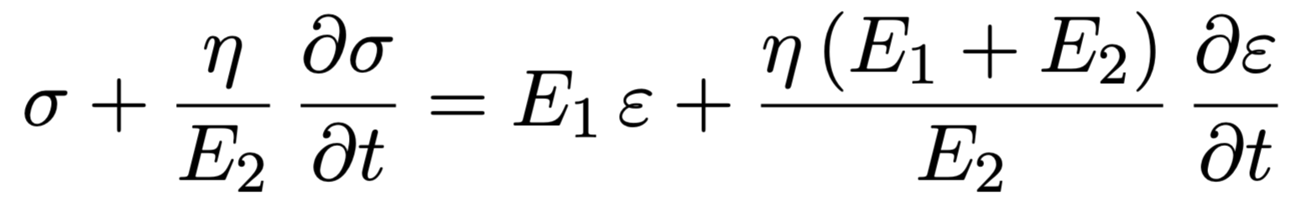
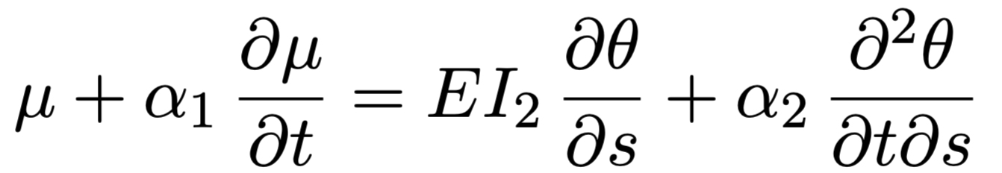
An approach to viscoelastic sheets
Maxwell 3 component system
Linear viscoelastic momentum constitutive law

Slide 19
Objectives identified by Gore
What is the stress, strain, and strain rate inside the cable at different cycling velocities and geometries?
How does the polymeric mechanical model change the stress, strain, and strain rate?
Polymer materials properties can be highly resolved by torsional shear testing. Can the stress, strain and strain rates of the cycled cable be transformed into torsional shear test inputs?
How will the cycle time/velocity change the performance over time?

Slide 20
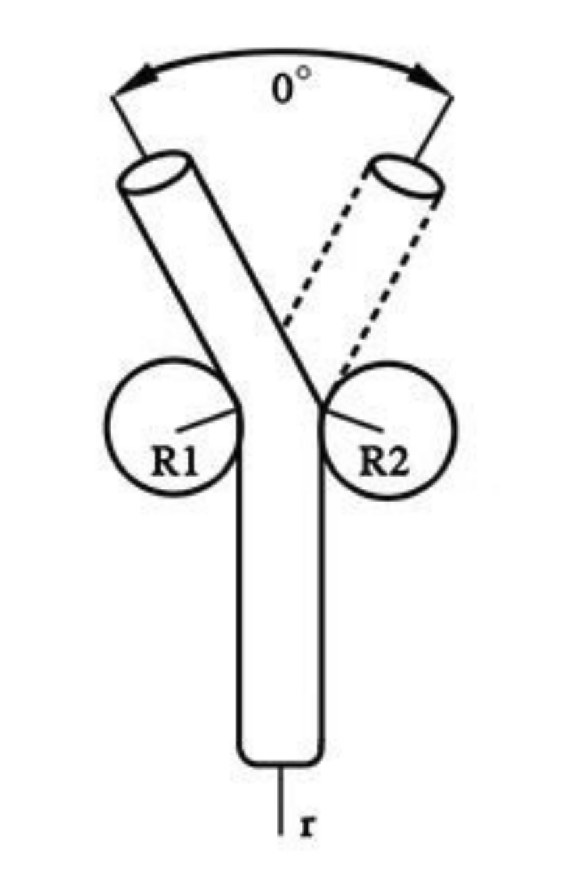
Discussion
Identified axial stresses and strains along the rods.
Identified bending rates experienced by the rod throughout motion.
  Translation to Tick-Tock experiments.
Future directions:
Solving Sine-Gordon wave equation subject to integral constraints.
Identifying fracture mechanisms and metrics to track fatigue in cables.

Slide 21
Acknowledgment
We gratefully acknowledge supports from
Society for Industrial and Applied Mathematics (SIAM)
National Science Foundation (NSF)
Drexel University
W.L. Gore & Associates Inc.

