Slide 1

SIAM Business Meeting
Financial Report 2025
Susan A. Palantino
Chief Operating Officer

Slide 2
2025 Revenues

Slide 3
2025 Expenses

Slide 4
2025 Expenses by Function
Miscellaneous expenses include Activity/Group/Sections/Chapters, Computer services, Advertising, Support of other organizations, Committee

Slide 5
Key Operating Results

Slide 6
Strong Balance Sheet Supports Long-Term Mission
Significant net assets and financial reserves
Strong liquidity position
Ability to fund strategic investments
Deferred revenue provides future revenue visibility
Financial flexibility during changing market conditions
Supports long-term sustainability and growth

Slide 7
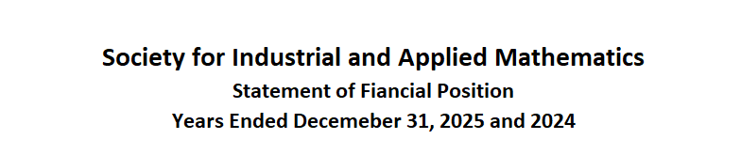
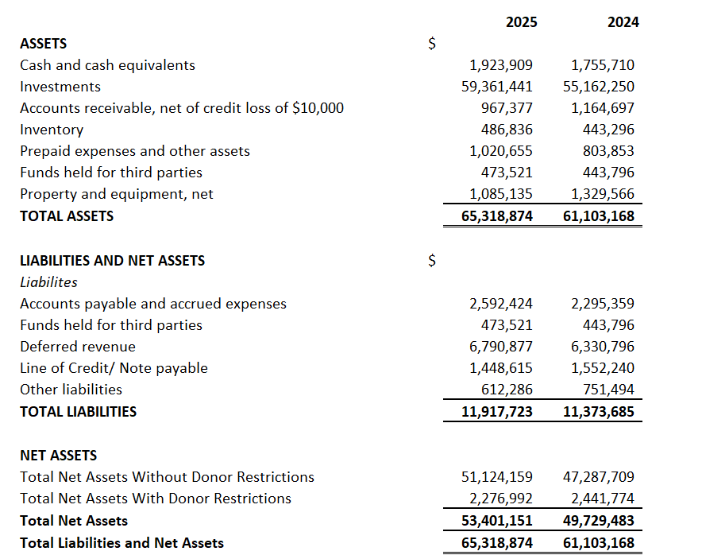

Slide 8
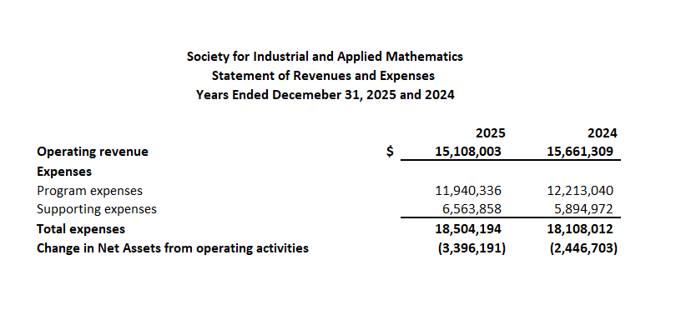

Slide 9
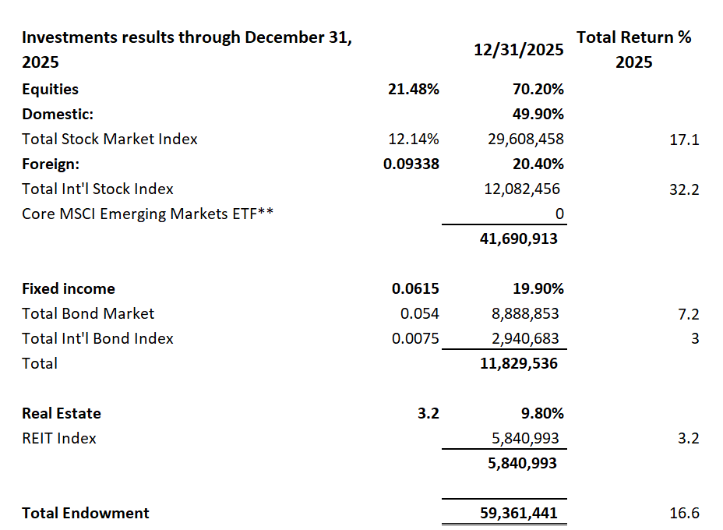
SIAM Investment Portfolio
December 31, 2025

Slide 10
Questions and Discussions

Slide 11
  Thank You

